Slide 1
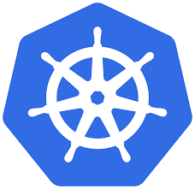
Kubernetes
(It’s Container Orchestration Tool)

Slide 2
Agenda
What is Container Orchestration ?
Why we need Container Orchestration ? (using Case study)
Which feature’s this tool offer’s ?
Let’s understand more clearer using Basic architecture [Master-Slave]
Where it actually used ?

Slide 3
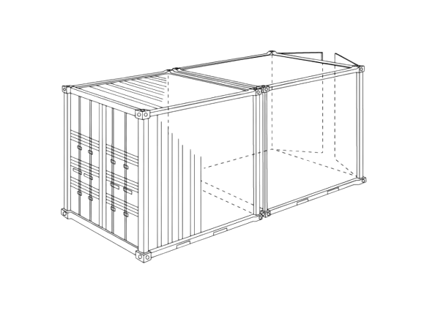
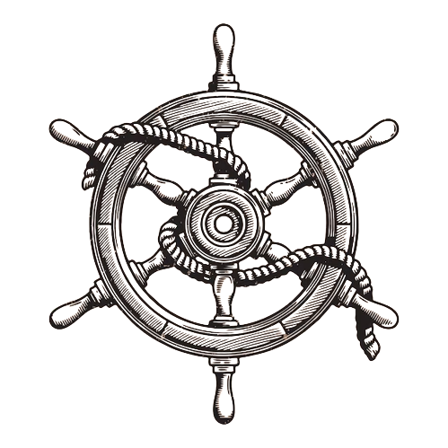
1.What is Container Orchestration?
Container + Orchestration
{Microservice’s} {Managing}
Managing complicated plan or event ,which were done secretly.

Slide 4
2. Why we need Container Orchestration ? (using Case study)
1)Trend from Monolithic to Microservices
2)Increased usage of containers
3)Demand for a proper way of managing those hundreds of
container

Slide 5

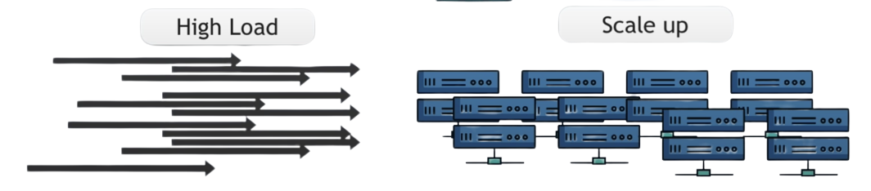

3. Which feature’s this tool offer ?
1)Deploying application
2)Rolling updates
3)High Availability or no downtime
﻿﻿4)Scalability or high performance
﻿﻿5)Disaster recovery - backup

Slide 6
4. Basic Architecture of Kubernetes
etdc
Anytime current state of Kubernetes
Cluster(disaster recovery)
User interface
Control manager
Kublet’s
(these are’s agent’s of worker nodes
Which helps to communicate and run container’s inside’s these worker node’s)
Master Node
Scheduler
etdc
Worker
Node’s

Slide 7
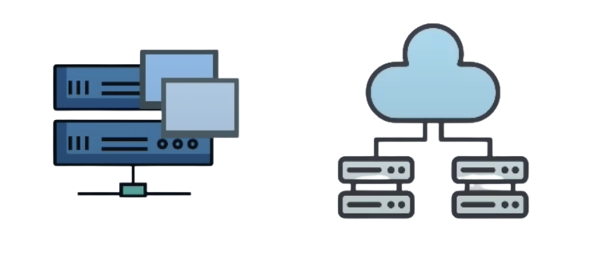
5.Where it actually used ?
Used in application’s in different deployment enivornment
Physical environment Cloud environment

Slide 8
Thank you :)

